Slide 1






IAM USER
S3 Bucket
Quick Sight
Glue
Athena
√
√
IAM USER
Project Flow
S2 Bucket
Data Catalogue
Quick Sight
Glue
Athena

Slide 2
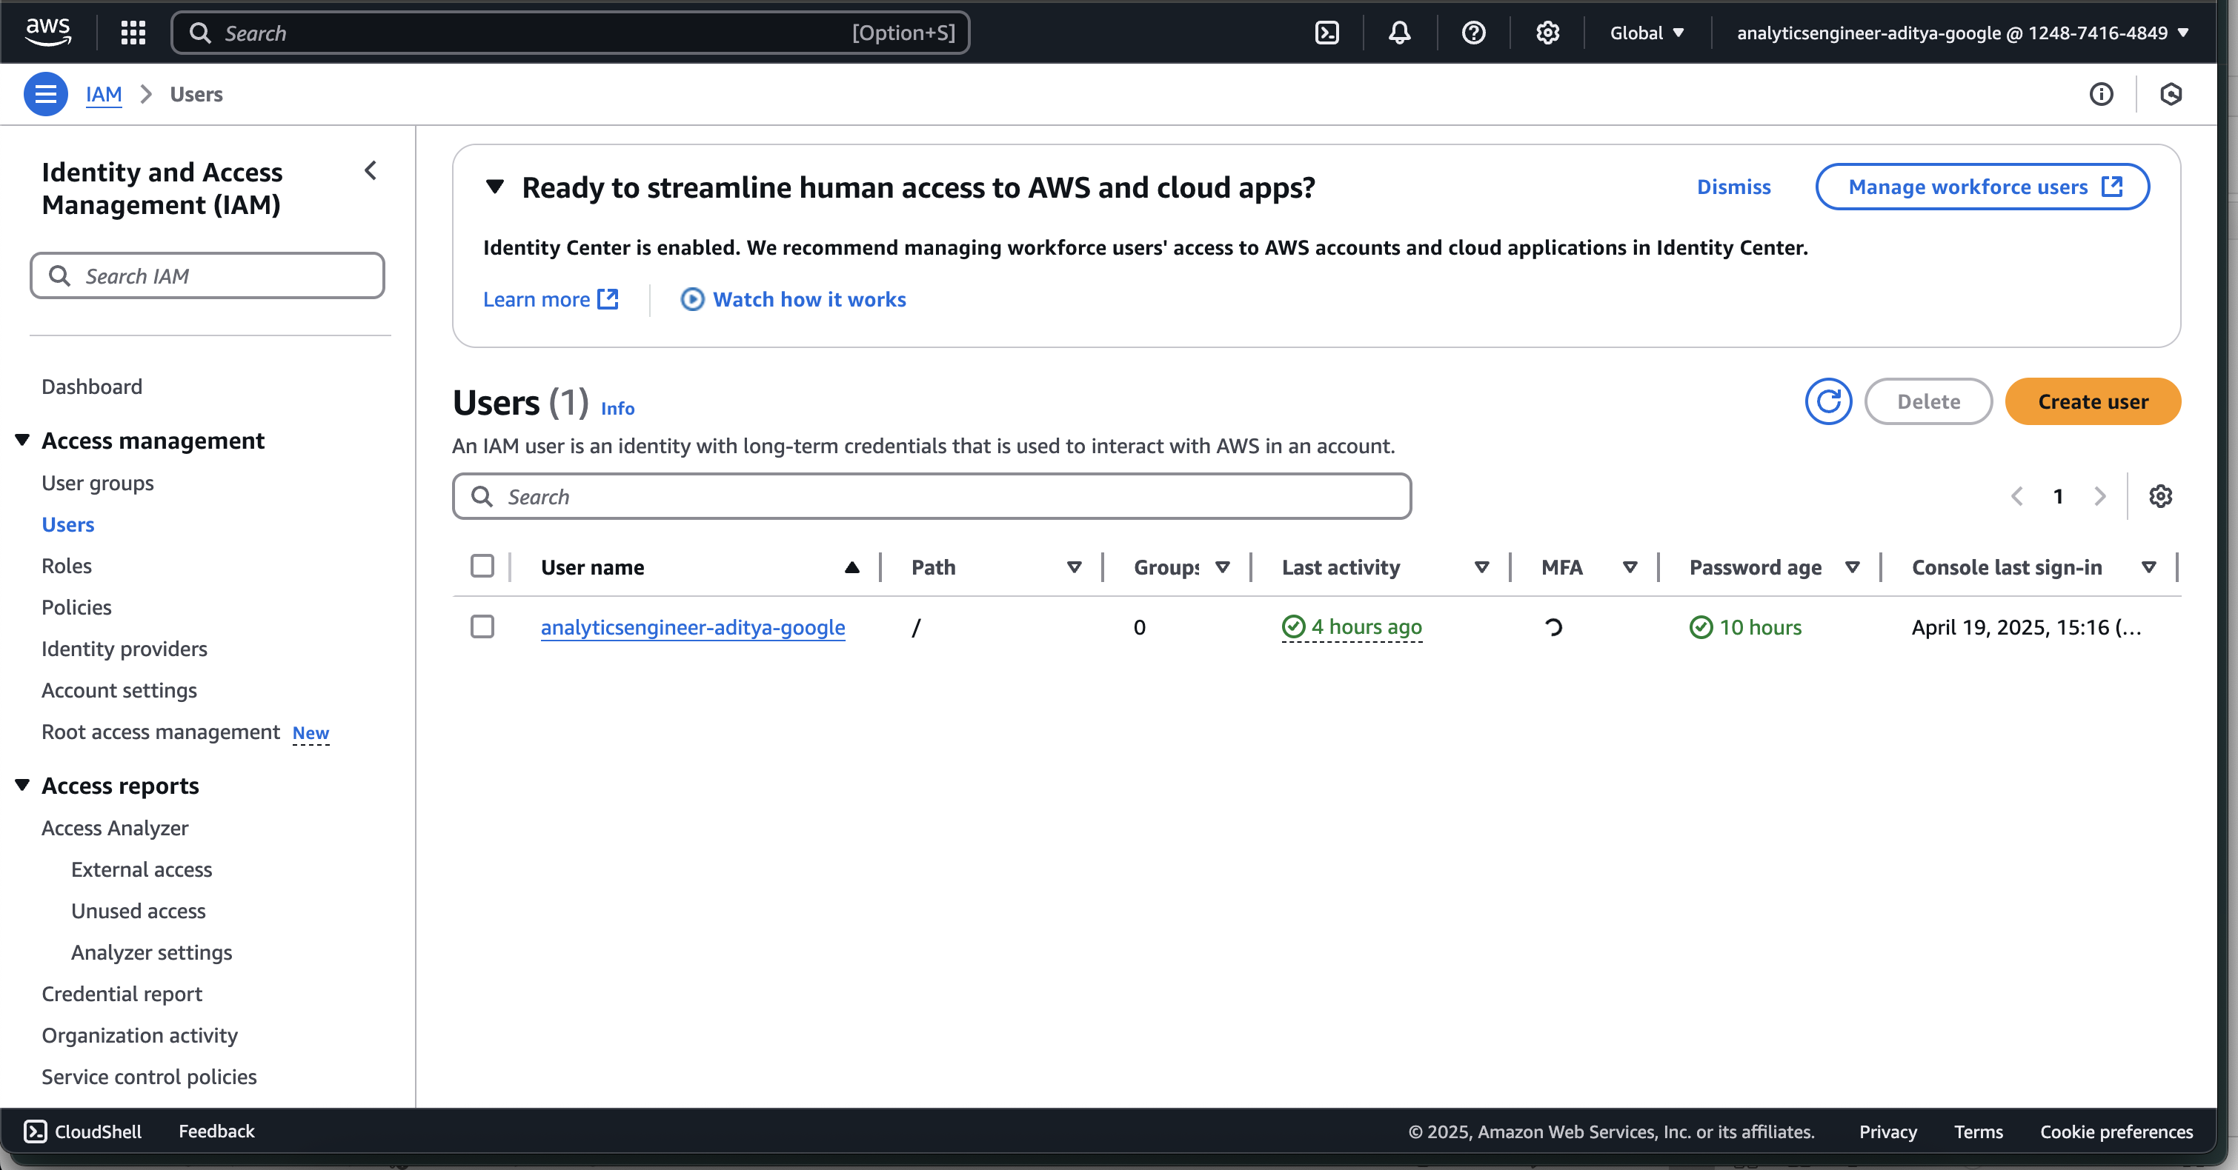
User Creation: I began by creating a new user with Admin access to ensure appropriate permissions for managing resources.
S2 Bucket
IAM USER
Project Flow
Quick Sight
Glue
Athena

Slide 3
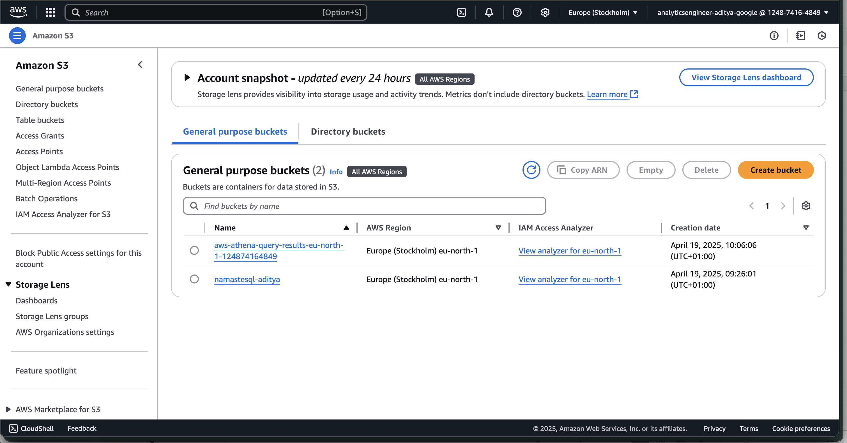
S3 Bucket Setup: I created a new S3 bucket to store the order data. Within this bucket, I organized the data by creating folders specifically for the order records.
Folder and Subfolder Structure: To ensure efficient data management and organization, I set up subfolders within the order data folder. A naming convention was applied to each subfolder, following the format Snapshot=YYYY-MM-DD (e.g., Snapshot=2027-01-01). This structure allowed me to create partitions based on the date.
Data Upload: The order data, which was in CSV format, was uploaded to the relevant subfolders in S3, ensuring that each file was properly categorized within its respective partition.
Glue
S3 Bucket
Athena
Quick Sight
Project Flow
IAM USER

Slide 4
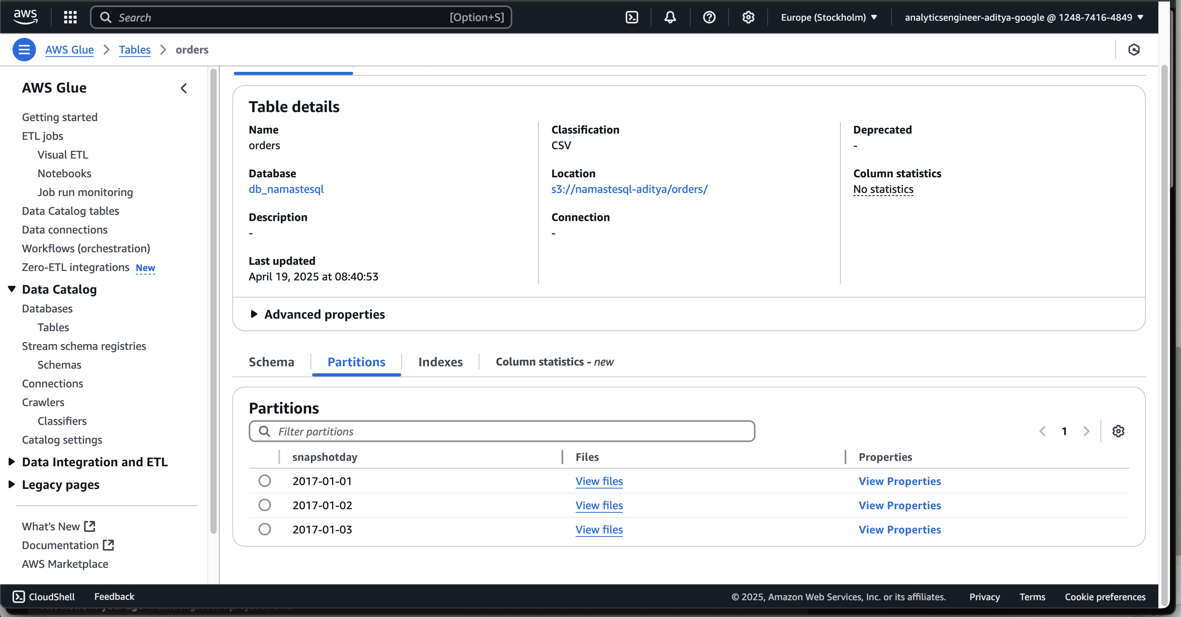
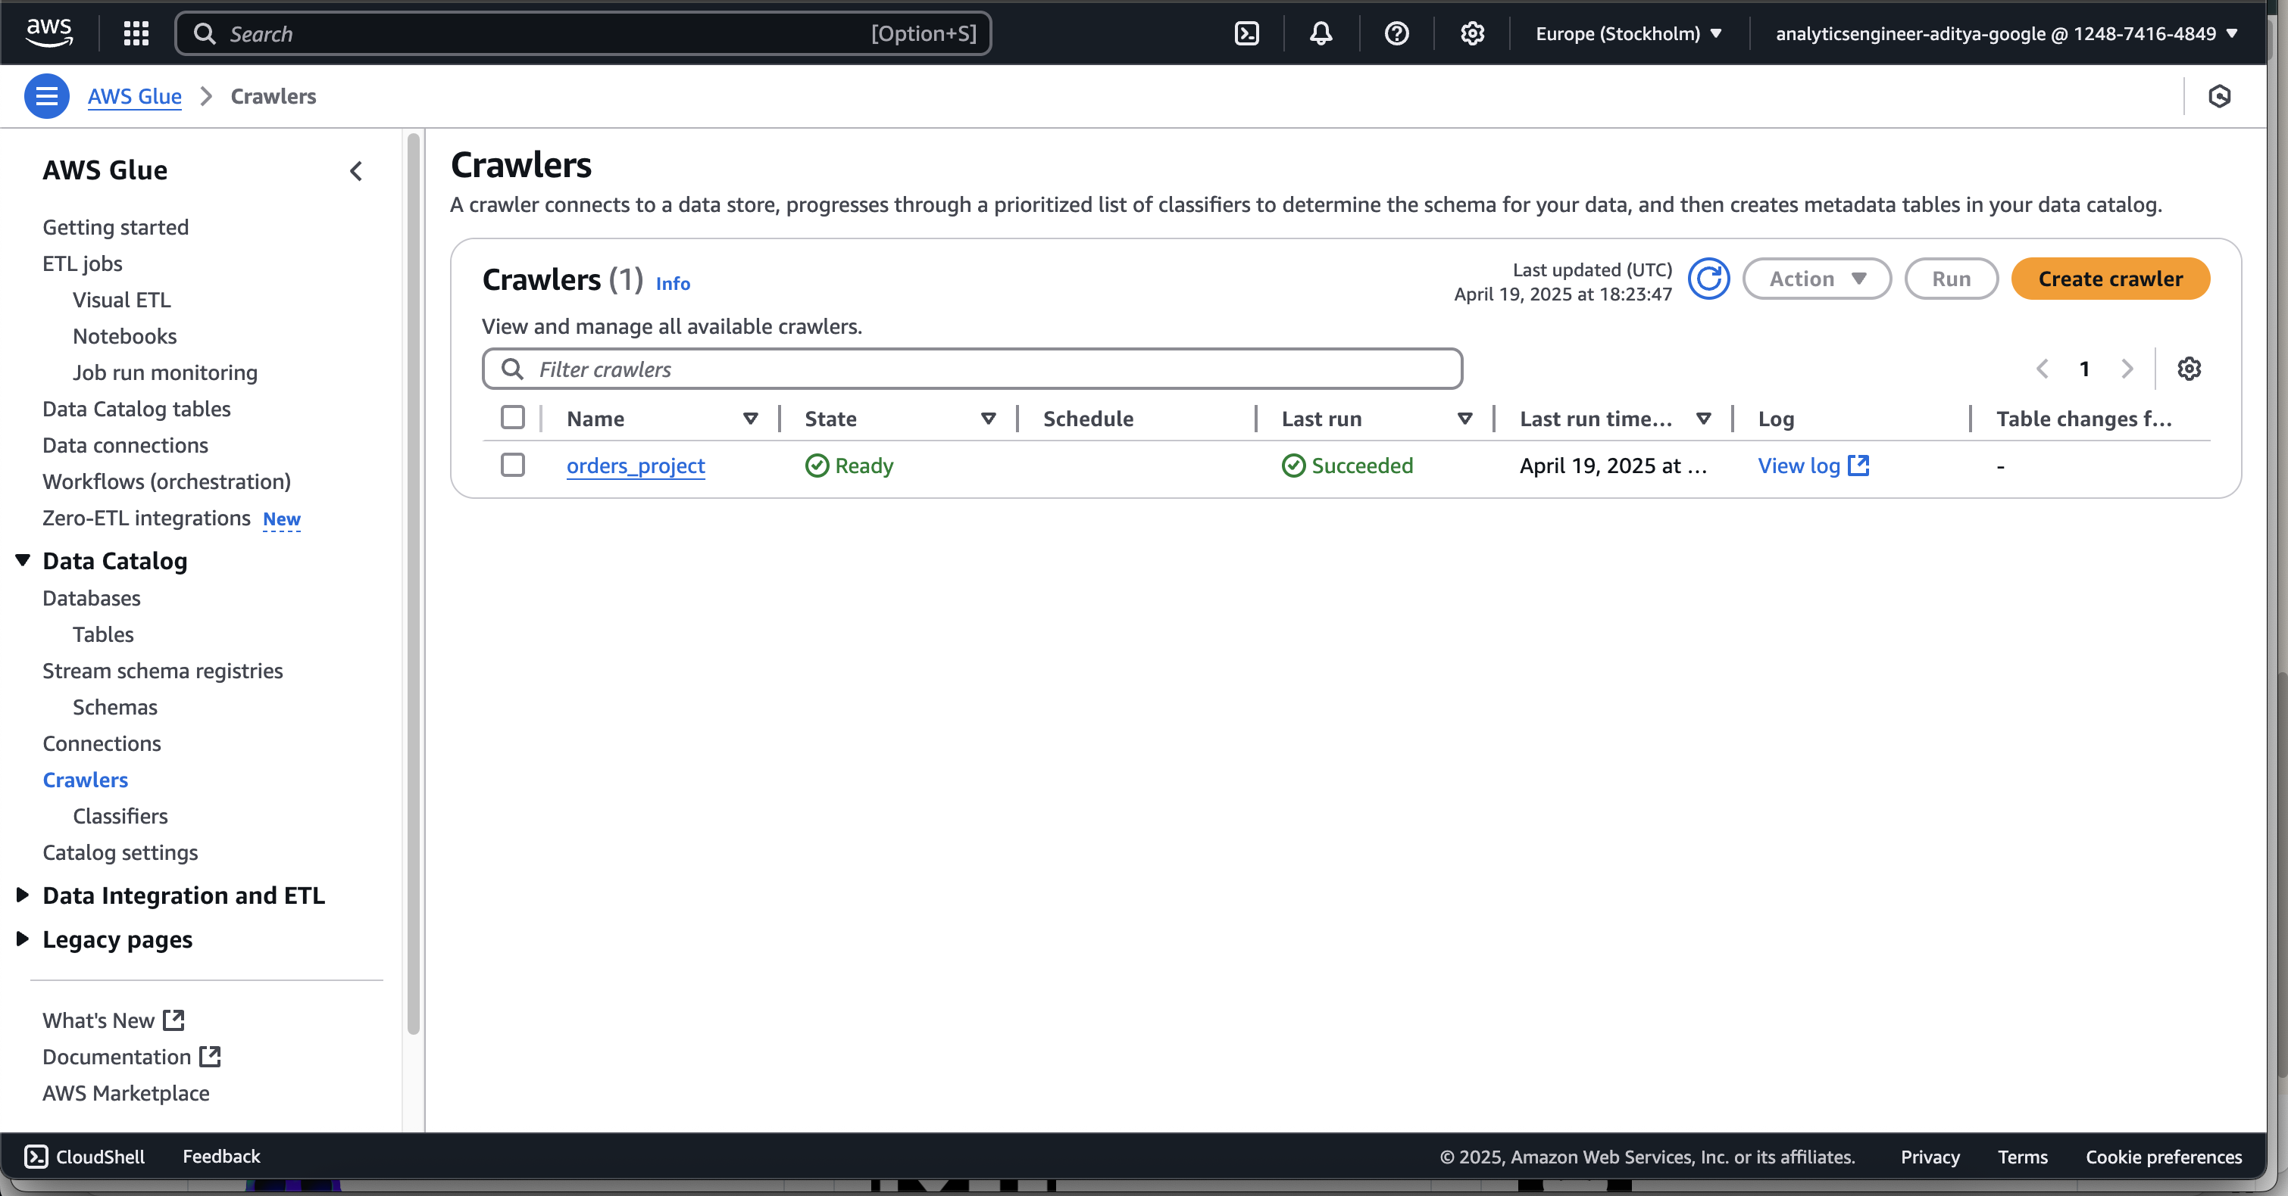
Crawler Setup: I created a new AWS Glue Crawler to automatically detect and catalog the data in S3. This helped in organizing the data in a way that could easily be queried using Athena.
Athena
Quick Sight
Glue
S2 Bucket
Project Flow
IAM USER

Slide 5
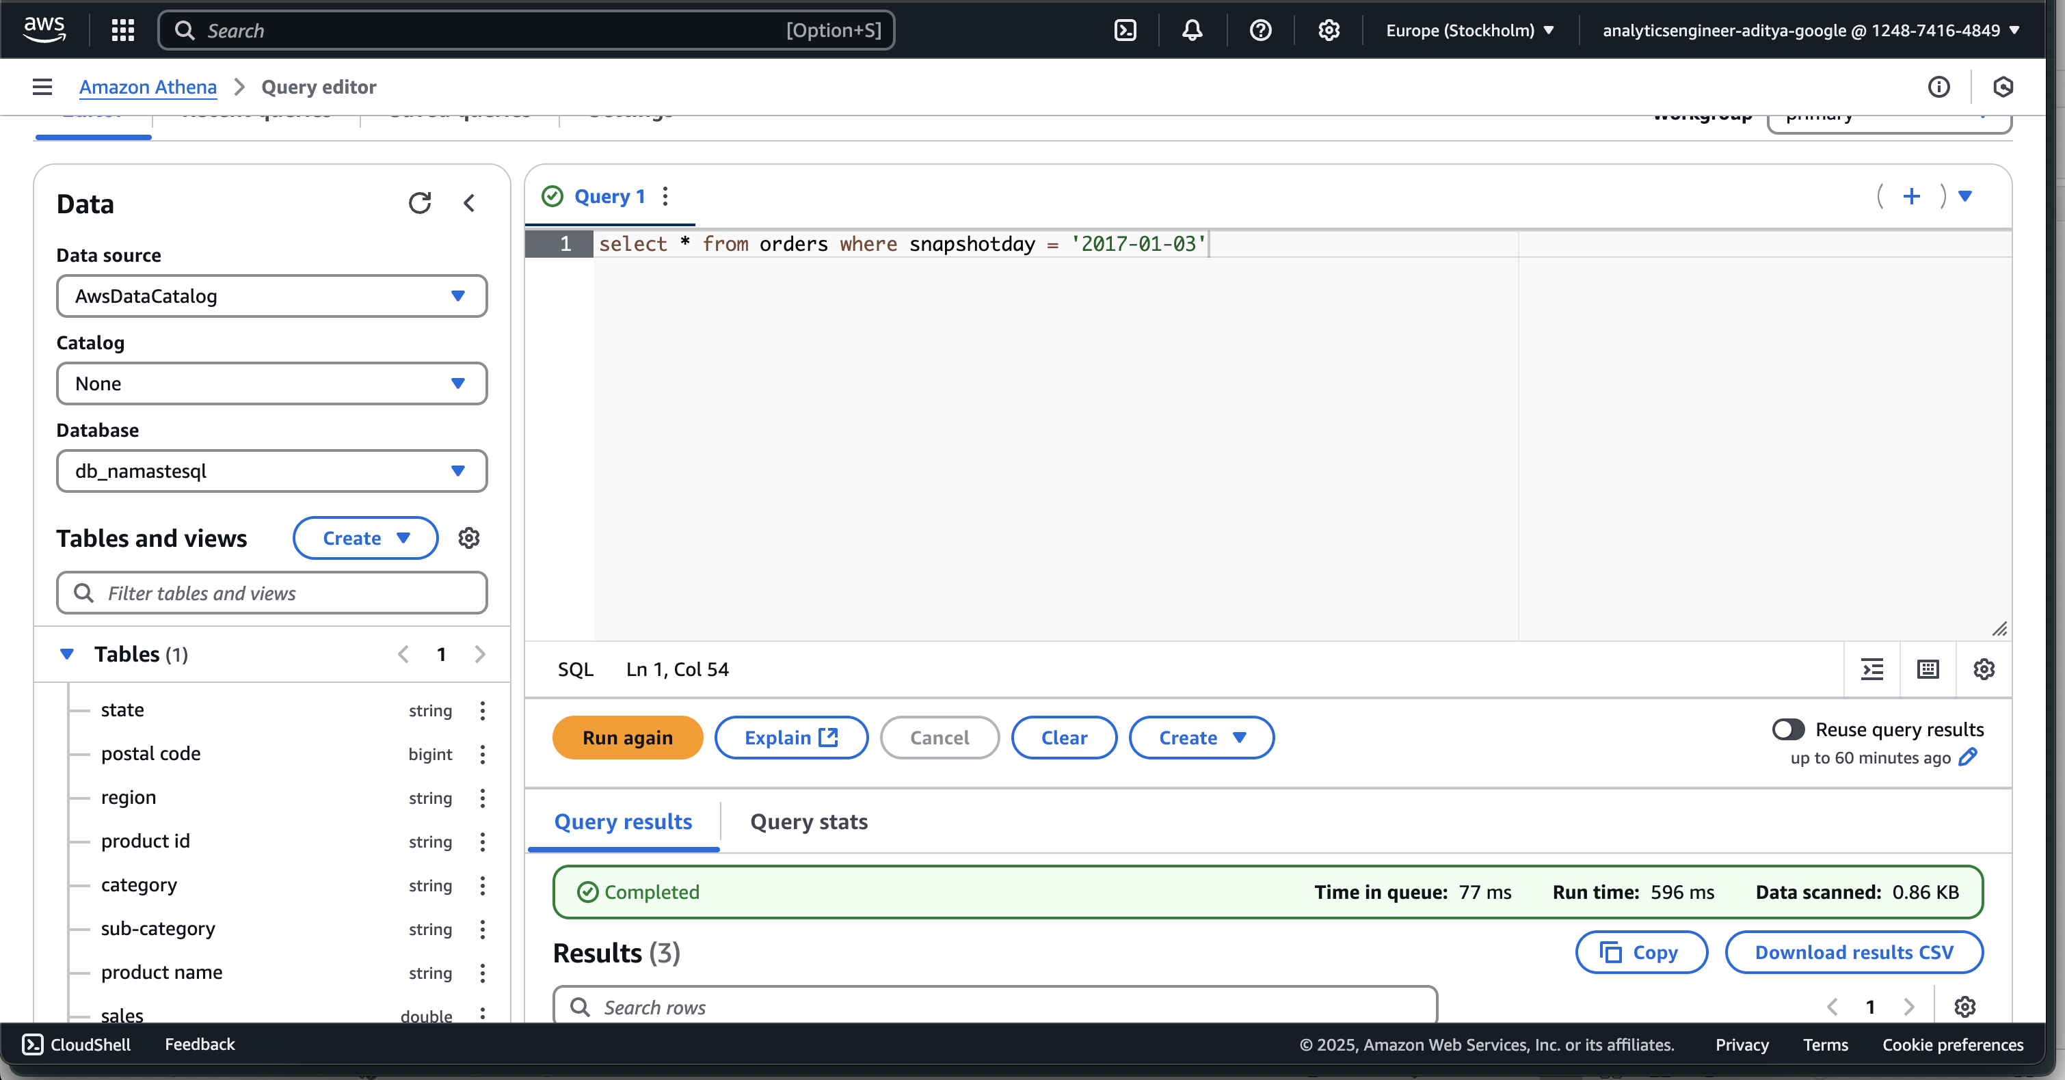
√
Data Query in Athena: After setting up the crawler, I used AWS Athena to query the uploaded data. I specified the query result location in S3 for storage and made sure that I could access the results efficiently.
Partition Optimization: One of the key optimizations was partitioning the data. By querying specific partitions (based on the snapshot date), I was able to significantly reduce the query cost. Instead of querying the entire dataset, only the relevant partition was accessed, which improved both performance and cost efficiency.
Quick Sight
Athena
Glue
S2 Bucket
Project Flow
IAM USER

Slide 6
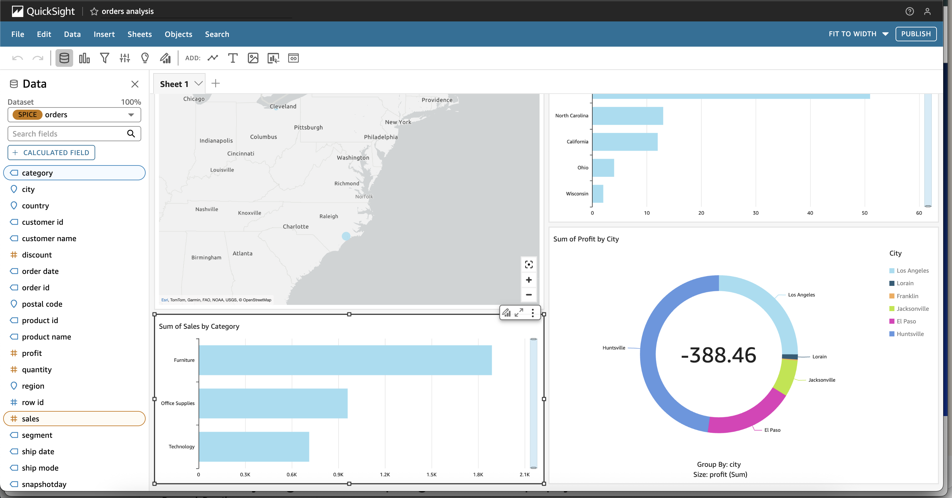
√
QuickSight Setup: To enable quick data visualization, I created a new Amazon QuickSight account. I connected QuickSight to Athena and selected the relevant dataset for analysis.
SPICE Import: To enhance visualization speed, I imported the data into SPICE (Super-fast, Parallel, In-memory Calculation Engine). This allowed for faster and more interactive dashboards.
Data Visualization: Using QuickSight, I created various charts and visualizations to better understand the data. Once finalized, I published these dashboards for stakeholders to access and interact with.
Quick Sight
Athena
Glue
S2 Bucket
Project Flow
IAM USER

